Slide 1

Electric Vehicle Analysis
Insights into the U.S. Electric Vehicle Market Trends and Adoption

Slide 2
Introduction
Electric vehicles (EVs) are transforming the automotive industry by providing sustainable alternatives to traditional vehicles. This presentation analyzes the U.S. electric vehicle market, focusing on Battery Electric Vehicles (BEVs) and Plug-in Hybrid Electric Vehicles (PHEVs). Using data from a comprehensive dataset, we will explore key trends, market dynamics, and consumer preferences to inform stakeholders about the current state and future potential of the EV market.

Slide 3





Objective of the Analysis
MARKET LANDSCAPE ASSESSMENT
ELECTRIC RANGE ANALYSIS
BEV AND PHEV SHARE MARKET
TRENDS BY MODEL YEAR
MANUFACTURER AND MODEL ANALYSIS

Slide 4
Dataset Overview
Key Attributes:
City: Vehicle registration location
State: State of registration
Postal Code: Registration postal code
Model Year: Year of vehicle manufacture
Make: Manufacturer name
Model: Specific vehicle model
Electric Vehicle Type: Classification (BEV or PHEV)
CAFV Eligibility: Clean Alternative Fuel Vehicle status
Electric Range: Distance the vehicle can travel on electric power
Base MSRP: Manufacturer's suggested retail price
Legislative District: Registration district
DOL Vehicle ID: Unique vehicle identifier
Vehicle Location: Physical location of the vehicle
Electric Utility: Utility provider information

Slide 5
Methodology
Analysis and Interpretation
Data Visualization
Data Exploration
Data Preparation
Data Collection

Slide 6
Key Performance Indicators (KPIs)
Total Vehicles
Average Electric Range
Total BEV Vehicles
Total PHEV Vehicles
Vehicles by Model Year
Vehicles by State
Top 10 Manufacturers
CAFV Eligibility
Top 10 Vehicle Models

Slide 7
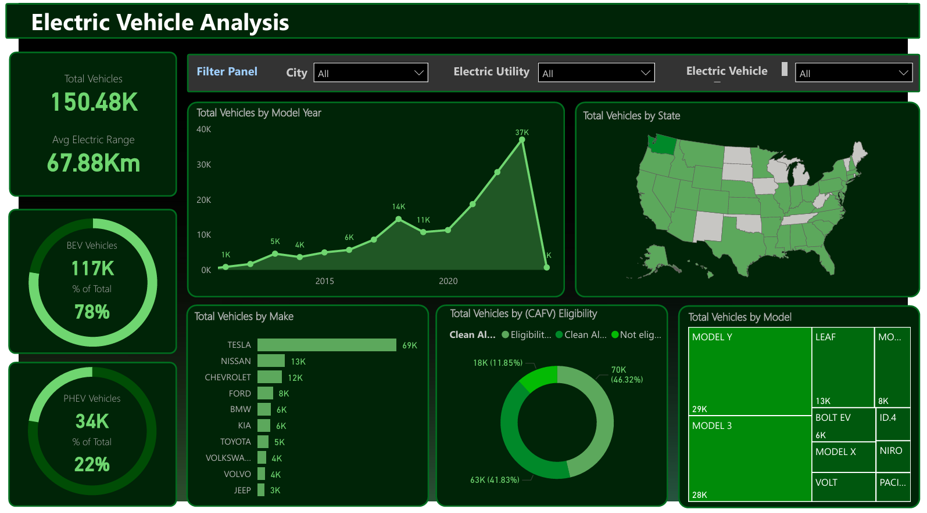
Analysis Report

Slide 8
Conclusion
The analysis reveals significant growth in the U.S. electric vehicle market, with BEVs leading in adoption.
Key insights include:
High total vehicle counts indicate a shift towards sustainable transportation.
Advancements in technology reflected in an impressive average electric range.
Geographic trends show varying adoption rates across states.
The findings offer valuable guidance for stakeholders, highlighting the need for continued innovation and investment in electric vehicle technology to meet rising consumer demand and promote sustainability.

Slide 9
Thank you

